Slide 1
Being God’s Temple pt. 1
make a sanctuary for me, and I will dwell among them.” (Exodus 25:8)

Slide 2
Being God’s Temple pt. 1
The Tabernacle of God
Means-Place of dwelling
God chose to meet with His people the Israelites for 40 years while they wandered in the desert under Moses’ leadership
It was a place where the people of God came together to worship and offer sacrifices to God.

Slide 3
Being God’s Temple pt. 1
The tabernacle provided a place where God could live among His people. It was a dwelling place for God’s divine presence.
In the New Testament, John writes: “The Word became flesh and made his dwelling among us.” (John 1:14). This word “dwelling” is the same word for “tabernacle” in the Old Testament.
In other words, God came in living flesh to dwell or to tabernacle among His people. As He walked upon the earth and lived among the Jews, Jesus Christ Himself fulfilled the picture of the Old Testament tabernacle. In that and many other ways, as we will see, the tabernacle really was a prophetic projection of the Lord’s redemptive plan for His people.

Slide 4
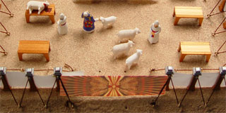
Being God’s Temple pt. 1
The Gate for the tabernacle
There was only one gate by which people could enter into the tabernacle courtyard. The gate was 30 feet wide. It was located directly in the center of the outer court on the east end. The gate was covered by a curtain or screen made of finely twisted linen in blue, purple and scarlet.
The one and only gate is a representation of Christ as the only way through which one could fellowship with God and worship Him. To do this, one must enter in through the gate to the place where God dwelled.

Slide 5
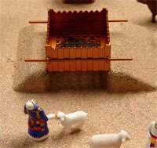
Being God’s Temple pt. 1
Brazen Altar
The first thing that one saw upon coming through the gate was the brazen altar, which served as a reminder of man’s sinfulness and his need for a blood sacrifice in order to be fellowship with God.
One needed to repent and offer sacrifices for their sin. Those who did not repent were not entering this “narrow way.”

Slide 6
Being God’s Temple pt. 1
Jesus said in his famous “I am” statements:
“I am the way and the truth and the life. No one comes to the Father except through me.” (John 14:6) and “I am the gate; whoever enters through me will be saved.” (John 10:9)He also said:
“Enter through the narrow gate. For wide is the gate and broad is the road that leads to destruction, and many enter through it. But small is the gate and narrow the road that leads to life, and only a few find it.” (Matthew 7:13-14)
The act of entering the gate to the tabernacle was significant to the Israelites. By entering, one could find forgiveness of sin and fellowship with God.

Slide 7
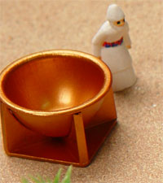
Being God’s Temple pt. 1
The Laver
The laver, or basin, was a large bowl filled with water located halfway between the brazen altar and the Holy Place. Although God did not give specific measurements for the Laver, it was to be made entirely of bronze. The priests were to wash their hands and their feet in it before entering the Holy Place.
The laver was located in a convenient place for washing and stood as a reminder that people need cleansing before approaching God. The priests atoned for their sins through a sacrifice at the brazen altar, but they cleansed themselves at the laver before serving in the Holy Place, so that they would be pure and not die before a holy God.

Slide 8
Being God’s Temple pt. 1
The Laver
The application for believers today is that we are forgiven through Christ’s work on the cross, but we are washed through His Word. We need to be washed daily in His Word to cleanse ourselves, so that we can serve and minister before Him.

Slide 9
Being God’s Temple pt. 1
“…Christ loved the church and gave himself up for her to make her holy, cleansing her by the washing with water through the word, and to present her to himself as a radiant church, without stain or wrinkle or any other blemish, but holy and blameless.” (Ephesians 5:25-27) “Let us draw near to God with a sincere heart in full assurance of faith, having our hearts sprinkled [with blood] to cleanse us from a guilty conscience and having our bodies washed with pure water.” (Hebrews 10:22)

Slide 10
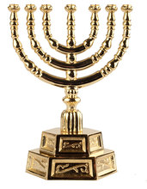
Being God’s Temple pt. 1
The Lampstand
The priests could enter the Holy Place, which was the first room in the tent of the tabernacle. There were three pieces of furniture in the Holy Place: the lampstand, the table of showbread and the golden altar of incense.
The “golden lampstand” or “candlestick,” stood at the left side of the Holy Place. It was hammered out of one piece of pure gold. Like for the laver, there were no specific instructions about the size of the menorah, but the fact that it was fashioned out of one piece of pure gold would have limited its size.

Slide 11
Being God’s Temple pt. 1
The fact that it was made of pure gold (not gold plated) and had seven branches. Pure gold is a representation of the deity and perfection of Jesus Christ, and seven is the number of completeness in the Bible. The believer is made complete by the perfection of Christ.
The lampstand had a central branch from which three branches extended from each side, forming a total of seven branches. Seven lamps holding olive oil and wicks stood on top of the branches. Each branch looked like that of an almond tree, containing buds, blossoms and flowers. The priests were instructed to keep the lamps burning continuously.

Slide 12
Being God’s Temple pt. 1
The lampstand was the only source of light in the Holy Place, so without it, the priests would have been moping around in the dark. The light shone upon the table of showbread and the altar of incense, enabling the priests to fellowship with God and intercede on behalf of God’s people.
Just as the lampstand was placed in God’s dwelling place so that the priests could approach God, Jesus, the “true light that gives light to every man” (John 1:9) came into the world so that man could see God and not live in spiritual darkness anymore. Jesus said:
“I am the light of the world. Whoever follows me will never walk in darkness, but will have the light of life.” (John 8:12)

Slide 13
Being God’s Temple pt. 1
“I have come into the world as a light, so that no one who believes in me should stay in darkness.” (John 12:46)Jesus is represented by the main branch of the lampstand, and we as believers are represented by the six branches that extend from original branch.
Having believed, we are now living as “children of light” (Ephesians 5:8) who draw our source of light from Jesus, the true light. Jesus calls us “light of the world” and commands us to “let your light shine before men, that they may see your good deeds and praise your Father in heaven” (Matthew 5: 14, 16).
Not only so, but the branches serve as a picture of Jesus’ description of our relationship with him: “I am the vine, you are the branches … apart from me you can do nothing” (John 15:5).

Slide 14
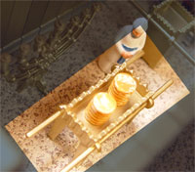
Being God’s Temple pt. 1
The Table of Showbread
The table of showbread was a small table made of acacia wood and overlaid with pure gold. It measured 3 feet by 1.5 feet and was 2 feet, 3 inches high. It stood on the right side of the Holy Place across from the lampstand and held 12 loaves of bread, representing the 12 tribes of Israel.
The priests baked the bread with fine flour and it remained on the table before the Lord for a week; every Sabbath day the priests would remove it and eat it in the Holy Place, then put fresh bread on the table. Only priests could eat the bread, and it could only be eaten in the Holy Place, because it was holy.

Slide 15
Being God’s Temple pt. 1
“Showbread” also was called “bread of the presence” because it was to be always in the Lord’s presence. The table and the bread were a picture of God’s willingness to fellowship and communion (literally speaking, sharing something in common) with man.
It was like an invitation to share a meal, an extension of friendship. Eating together often is an act of fellowship. God was willing for man to enter into His presence to fellowship with Him, and this invitation was always open.

Slide 16
Being God’s Temple pt. 1
“Showbread” also was called “bread of the presence” because it was to be always in the Lord’s presence. The table and the bread were a picture of God’s willingness to fellowship and communion (literally speaking, sharing something in common) with man.
It was like an invitation to share a meal, an extension of friendship. Eating together often is an act of fellowship. God was willing for man to enter into His presence to fellowship with Him, and this invitation was always open.

Slide 17
Being God’s Temple pt. 1
The Table of Showbread
Jesus exemplified this when He ate with tax collectors, prostitutes and the sinners of Jewish society. But this was more than just a gesture of friendship on earth. Jesus came to call sinners to Him, make them right with God, so that they could enjoy everlasting fellowship with God.
“I am the bread of life. He who comes to me will never go hungry, and he who believes in me will never be thirsty. … Your forefathers ate the manna in the desert, yet they died. But here is the bread that comes down from heaven, which a man may eat and not die.” (John 6:35, 49-50)
God so desires our fellowship that He was willing to come to earth from heaven as our “bread of life” to give eternal life to all those who would partake in it. At Jesus’ last Passover meal with His disciples, Jesus described Himself as bread again:

Slide 18
Being God’s Temple pt. 1
The Table of Showbread
“While they were eating, Jesus took bread, gave thanks and broke it, and gave it to his disciples, saying, ‘Take and eat; this is my body.’” (Matthew 26:26)Jesus’ broken body is our only access to fellowship with God.
Today, we celebrate the Lord’s Supper, or communion, to remember this important truth. And today, as in the day of Moses’ tabernacle, God still desires to have fellowship and sit down for a feast with His people.
“Here I am! I stand at the door and knock. If anyone hears my voice and opens the door, I will come in and eat with him, and he with me.” (Revelations 3:20)

Slide 19
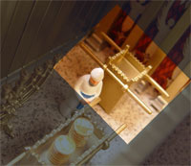
Being God’s Temple pt. 1
Altar of Incense
The golden altar of incense, which is not to be confused with the brazen altar, sat in front of the curtain that separated the Holy Place from the Holy of Holies. This altar was smaller than the brazen altar. It was a square with each side measuring 1.5 feet and was 3 feet high. It was made of acacia wood and overlaid with pure gold. Four horns protruded from the four corners of the altar.
God commanded the priests to burn incense on the golden altar every morning and evening, the same time that the daily burnt offerings were made.

Slide 20
Being God’s Temple pt. 1
Altar of Incense: The incense was to be left burning continually throughout the day and night as a pleasing aroma to the Lord. It was made of an equal part of four precious spices (stacte, onycha, galbanum and frankincense) and was considered holy. God commanded the Israelites not to use the same formula outside the tabernacle to make perfume for their own consumption; otherwise, they were to be cut off from their people (Exodus 30:34-38).
The incense was a symbol of the prayers and intercession of the people going up to God as a sweet fragrance. God wanted His dwelling to be a place where people could approach Him and pray to Him. “…for my house will be called a house of prayer for all nations.” (Isaiah 56:7)

Slide 21
Being God’s Temple pt. 1
The golden altar, furthermore, is a representation of Christ, who is our intercessor before God the Father. During His days on earth, Jesus prayed for the believers. He was like the high priest of the tabernacle, who bore the names of each of the Israelite tribes on his breastplate before God.
Just before He was betrayed and sentenced to death, Jesus interceded for His disciples and all believers, asking God to guard them from evil and sanctify them by His Word, and that they may see God’s glory and be a witness to the world (John 17:1-26). Today, Jesus still is our high priest at the Father’s side, interceding for God’s people:

Slide 22
Being God’s Temple pt. 1
Since we have been forgiven of our sins through the blood of Christ, we also come boldly in prayer in Jesus’ name. When we pray in Jesus’ name, we are praying based on the work He has done and not on our own merit. It is in His powerful name that we are saved and baptized, and in His name we live, speak and act.
Symbolic of Heaven: Another angel, who had a golden censer, came and stood at the altar. He was given much incense to offer, with the prayers of all the saints, on the golden altar before the throne. The smoke of the incense, together with the prayers of the saints, went up before God from the angel’s hand.” (Revelations 8:3-4)

Slide 23
Being God’s Temple pt. 1
The Altar of Incense: The horns of the golden altar were sprinkled with blood from the animal sacrifice to cleanse and purify it from the sins of the Israelites (Leviticus 4:7, 16:18).
Just as the horns on the brazen altar represent the power of Christ’s blood to forgive sins, the horns on golden altar signify the power of His blood in prayer as we confess our sins and ask for His forgiveness.
And the prayer offered in faith will make the sick person well; the Lord will raise him up. If he has sinned, he will be forgiven. Therefore confess your sins to each other and pray for each other so that you may be healed. The prayer of a righteous man is powerful and effective.” (James 5:15-16)

Slide 24
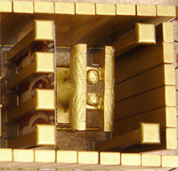
Being God’s Temple pt. 1
The Holy of Holies & The Veil
Within the Holy Place of the tabernacle, there was an inner room called the Holy of Holies, or the Most Holy Place. It was a most sacred room, a place no ordinary person could enter. It was God’s special dwelling place in the midst of His people. During the Israelites’ wanderings in the wilderness, God appeared as a pillar of cloud or fire in and above the Holy of Holies. The Holy of Holies was a perfect cube — its length, width and height were all equal to 15 feet.
A thick curtain separated the Holy of Holies from the Holy Place. This curtain, known as the “veil,” was made of fine linen and blue, purple and scarlet yarn. There were figures of cherubim (angels) embroidered onto it. Cherubim, spirits who serve God, were in the presence of God to demonstrate His almighty power and majesty.
They also guarded the throne of God. These cherubim were also on the innermost layer of covering of the tent. If one looked upward, they would see the cherubim figures.

Slide 25
Being God’s Temple pt. 1
The Veil
The picture of the veil was that of a barrier between man and God, essentially, it was shielding a holy God from sinful man. The veil was a barrier to make sure that man could not carelessly and irreverently enter into God’s awesome presence.
Even as the high priest entered the Holy of Holies on the Day of Atonement, he had to make some meticulous preparations: He had to wash himself, put on special clothing, bring burning incense to let the smoke cover his eyes from a direct view of God, and bring blood with him to make atonement for sins.
“But only the high priest entered the inner room, and that only once a year, and never without blood, which he offered for himself and for the sins the people had committed in ignorance.” (Hebrews 9:7)

Slide 26
Being God’s Temple pt. 1
The Veil
So the presence of God remained shielded from man behind a thick curtain during the history of Israel. However, Jesus’ sacrificial death on the cross changed that.
When He died, the curtain in the Jerusalem temple was torn in half, from the top to the bottom. Only God could have carried out such an incredible feat because the veil was too high for human hands to have reached it, and too thick to have torn it. (The Jerusalem temple, a replica of the wilderness tabernacle, had a curtain that was about 60 feet in height, 30 feet in width and four inches thick.)
Furthermore, it was torn from top down, meaning this act must have come from above.

Slide 27
Being God’s Temple pt. 1
As the veil was torn, the Holy of Holies was exposed. God’s presence was now accessible to all. Shocking as this may have been to the priests ministering in the temple that day, it is indeed good news to us as believers, because we know that Jesus’ death has atoned for our sins and made us right before God.
The torn veil illustrated Jesus’ body broken for us, opening the way for us to come to God. As Jesus cried out “It is finished!” on the cross, He was indeed proclaiming that God’s redemptive plan was now complete. The age of animal offerings was over. The ultimate offering had been sacrificed.
We can now boldly enter into God’s presence, “the inner sanctuary behind the curtain, where Jesus, who went before us, has entered on our behalf.” (Hebrews 6:19-20)

Slide 28
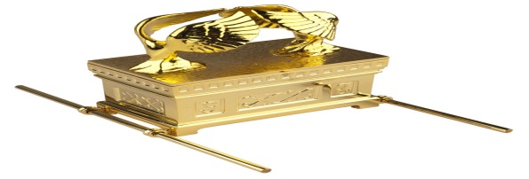
Being God’s Temple pt. 1
Ark of the Covenant
Within the Holy of Holies, shielded from the eye of the common man, was one piece of furniture comprising two parts: the Ark of the Covenant and the atonement cover (or “mercy seat”) on top of it.
The ark was a chest made of acacia wood, overlaid with pure gold inside and out. It was 3 feet, 9 inches long and 2 feet, 3 inches wide and high.
God commanded Moses to put in the ark three items: a golden pot of manna, Aaron’s staff that had budded, and the two stone tablets on which the Ten Commandments were written.

Slide 29
Being God’s Temple pt. 1
The Ark of the Covenant
The atonement cover was the lid for the ark. On top of it stood two cherubim (angels) at the two ends, facing each other. The cherubim, symbols of God’s divine presence and power, were facing downward toward the ark with outstretched wings that covered the atonement cover. The whole structure was beaten out of one piece of pure gold. The atonement cover was God’s dwelling place in the tabernacle. It was His throne, flanked by angels.
God said to Moses: “There, above the cover between the two cherubim that are over the ark of the Testimony, I will meet with you and give you all my commands for the Israelites.” (Exodus 25:22) “Tell your brother Aaron not to come whenever he chooses into the Most Holy Place behind the curtain in front of the atonement cover on the ark, or else he will die, because I appear in the cloud over the atonement cover.” (Leviticus 16:2)

Slide 30
Being God’s Temple pt. 1
The Ark of the Covenant
Above the ark and the atonement cover, God appeared in His glory in “unapproachable light” (1 Timothy 6:16). This light is sometimes referred to as the Shekinah glory. The word Shekinah, although it does not appear in our English bibles, has the same roots as the word for tabernacle in Hebrew and refers to the presence of the Lord.
Because the ark was God’s throne among His people, it was a symbol of His presence and power with them wherever it went. There are quite a number of miracles recorded in the Old Testament surrounding the ark: With the presence of the ark, the waters of the River Jordan divided so the Israelites could cross on dry land, and the walls of Jericho fell so that the Israelites could capture it (Joshua 3:14-17, 6:6-21).

Slide 31
Being God’s Temple pt. 1
The Ark of the Covenant
Yet the ark could not be treated with irreverence because it was also a symbol of God’s judgment and wrath.
When the Israelites fought their enemies the Philistines during the time of the prophet Samuel, they disregarded the commands of the Lord and took the ark out to the battlefield with them, “summoning” God’s presence. God caused the Philistines to win the battle and “the glory departed from Israel, for the ark of the Lord was taken” (1 Samuel 4:22).
However, God showed His power to the Philistines when He caused their idol, Dagon, to fall to the ground when the ark was placed next to it, and several Philistine cities were plagued heavily when the ark was in their midst (1 Samuel 5). Ultimately, the ark was returned to Israel.

Slide 32
Being God’s Temple pt. 1
God keeps His Covenant Concerning Us.
The Israelites found acceptance with God by believing His word to be true — that when their sins were covered by blood, God temporarily overlooked their sins as if they had been obliterated.
But Jesus Christ has become our permanent atonement cover. Through Jesus’ blood, our sins have been covered over. When God looks at us, He doesn’t see our sin, but the provision: His own Son. Jesus lay down His life for us as an innocent sacrifice so that God would look on us and see His perfection.
The atonement cover of the Ark of the Covenant was God’s throne in the midst of the Israelites. God is on His throne today in heaven and Jesus, our high priest, is at His right side. When we come to God now, we approach a throne of grace.
We are God’s Temple “Let us then approach the throne of grace with confidence, so that we may receive mercy and find grace to help us in our time of need.” (Hebrews 4:16)

Slide 33
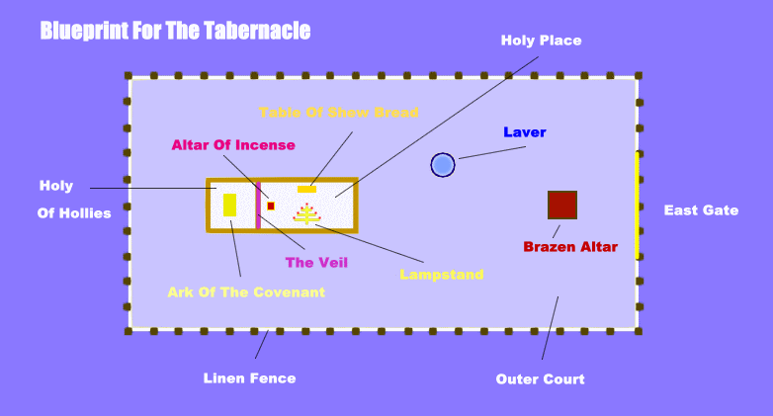
Being God’s Temple pt. 1

Slide 34
For Next Week 4/1/15
Topic: Being God’s Temple pt. 2
I John 2:16-17
Prov. 2:1-8
James 3:1-12
I Cori. 6:12-20

Slide 35
References
The Ark of the Covenant and Atonement Cover-The Tabernacle Place-the-tabernacle-place.com/articles/what_is_the_tabernacle

