Slide 1
Developing in God-Know What He Hates
There are six things that the Lord hates, seven that are an abomination to him: haughty eyes, a lying tongue, and hands that shed innocent blood, a heart that devises wicked plans, feet that make haste to run to evil, a false witness who breathes out lies, and one who sows discord among brothers” (Proverbs 6:16-19, NASB)

Slide 2
What God Hates
God doesn’t leave us to our own devices.
He helps us to know how we are to live and behave to please Him.
When we truly examine what God does say to us concerning how we are to behave, we find His request are not hard.
He always watches out for use so we don’t hurt ourselves or others.
Everything He says or does is for our benefit.

Slide 3
What God Hates
The seven things God hates are the sins that deal with the deep heart motives of the individual.
Sin is committed the moment it is conceived in the heart, even before it is actually committed.
Avoiding the seven things God hates will help us expose our hidden intentions and motives.

Slide 4
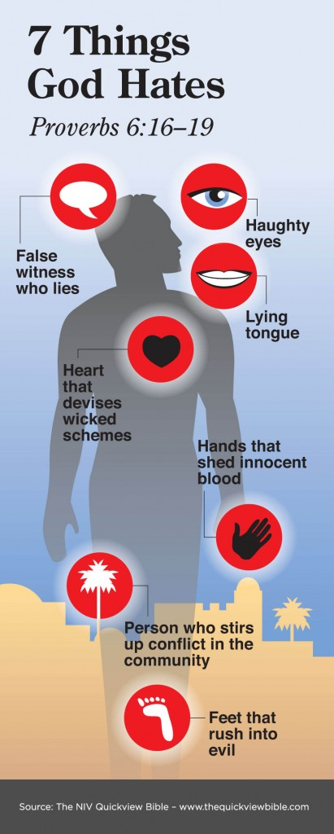
What God Hates

Slide 5
What God Hates
What does it mean to be arrogant?

Slide 6
What God Hates
Arrogant (haughty) eyes
This describes a feeling of pride and looking down upon others
When we begin to think of ourselves more highly and with unparalleled importance
We forget the fact that anything good in us is the result of Christ living in us and that the old self is now dead
Often, believers feel superior to other believers when they receive godly wisdom and display amazing tenacity against sin.
We fail to realize these gifts were given by God through Christ and the power of the Holy Spirit and are not due to our own goodness.

Slide 7
What God Hates
Lying tongue:
A lying tongue is one that speaks falsehood, knowingly and willingly, with an intention to deceive others.
Lying can be used to put down the character of a brother/sister or to flatter a friend.
It is a most detestable evil to God, who is a God of truth.
Nothing we do causes us to more closely resemble the devil, who is the father of lies

Slide 8
What God Hates
What does it mean hands that shed innocent blood?

Slide 9
What God Hates
Hands that shed innocent blood:
This refers to cold-blooded murder.
We may never have to go through the motions of killing someone or never have touched a gun or knife, but in Matthew 5:21–24, Jesus says that anyone hating someone else unreasonably without offering room for forgiveness commits a sin and is in danger of hell’s fire.
Agree with your adversary quickly. Leave your gift at the alter and be reconciled to your brother/sister first.
1 John 3:15- Whoever hates his brother is a murderer, and you know that no murderer has no eternal life abiding in him.

Slide 10
What God Hates
Describe ways your heart can devise wickedness

Slide 11
What God Hates
A heart that devises wicked schemes:
This means thinking or conceiving evil against any individual or group for personal benefit or other misguided objectives. (Things you act our in your thoughts or in your mirror)
Example, David’s sin against Uriah the Hittite and Bathsheba comes to mind when he schemed and got Uriah killed.
The heart of an evil man continually comes up with schemes, plans to bring others to ruin, whether physically or spiritually.

Slide 12
What God Hates
In What Way Can Are Feet Rush Into Evil?

Slide 13
What God Hates
Feet that are quick to rush into evil:
Those whose feet are quick to rush into evil display no resistance.
Galatians 5:16- Walk in the Spirit and you will not fulfill the lust of the flesh.
we are expected to be wise in this regard (Romans 6:11–14)-Be dead to sin but alive to God in Christ Jesus our Lord.
We need to demonstrate the attitude of Jesus: when tired and hungry after forty days and forty nights of fasting, He refused to yield to the devil’s tempting and killed the temptation in His mind without allowing it to grow into sin (Matthew 4:1–11).
“Resist the devil and he will flee from you” (James 4:7).

Slide 14
What God Hates
What is a false witness?

Slide 15
What God Hates
False witness who pours out lies
Similar to the sin of the lying tongue mentioned earlier, this form of lying is given special mention as it could send an innocent person to jail.
Examples, false witnesses as instigated by the wicked Jezebel (1 Kings 21:8–14) to kill Naboth for his vineyard.
As Christians are new creations in Christ (2 Corinthians 5:17), and, as such, we reflect His nature.
We have been released from our “old self” with its evil practices such as lying and bearing false witness.

Slide 16
What God Hates
What are ways we can stir up discord among our brothers and sisters?

Slide 17
What God Hates
A man who stirs up dissension/discord among brothers:
We are to work to maintain the unity among our brothers and sisters. (Psalm 133:1; 1 Thessalonians 4:9).
In many situations strife/differences among brothers and even within the church may at times be unavoidable. We may not always agree on a particular subject, but still work together to get the things of God done.
Anyone who purposely causes disruption to peace in the body of Christ will displease God above all, since that person gives room for others to sin and for himself to sin further (1 John 2:9–11; 4:19–21).
As peace makers we are called the “sons & daughters of God” (Matthew 5:9).

Slide 18
What God Hates
God’s nature is love—He always does what is best for others—and He hates what is contrary to His nature—He hates what is contrary to love.
No one should be surprised to learn that God does hate some things.
He created us with the capacity to both love and hate, and we acknowledge that hatred is sometimes justified—we naturally hate things that destroy what we love.
This is part of our being created in the image of God.
Develop in your love for God as you learn more about Him.
What God hates are things that are within our power to change with the assistance of the Holy Spirit.

Slide 19
Next Bible Study
TBA

Slide 20
Resources
Seven things God hates-gotquestions.org

