Slide 1
God’s Masterpiece-In Progress
My old self has been crucified with Christ. It is no longer I who live, but Christ lives in me. ~ Galatians 2:20 (NLT)

Slide 2
God’s Masterpiece-In Progress
Remember the moment when you first decided to live for Christ?
God's desire from that very second has been to turn you into His very own Masterpiece.
It is our responsibility to putting ourselves in the hand of the Potter.
We have to make ourselves available to be molded into the person He originally created us to be.

Slide 3
God’s Masterpiece-In Progress
seek the [rich, eternal treasures] that are above, where Christ is, seated at the right hand of God. For [as far as this world is concerned] you have died, and your [new, real] life is hidden with Christ in God. - Colossians 3:1, 3 (AMP)
How different is this new life supposed to look?

Slide 4
God’s Masterpiece-In Progress
Where do most of your thoughts dwell?
On things of this earthly realm, or on things of eternal value?
All of the things that we spend most of our lives worrying about don't even matter!
Our real life is actually "hidden with Christ in God."

Slide 5
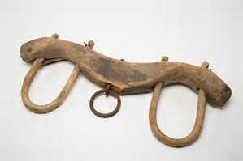
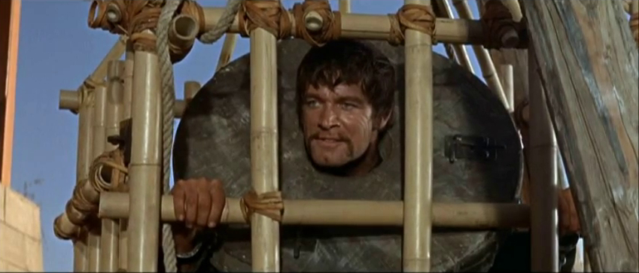
God’s Masterpiece-In Progress
What is bondage? Bondage implies slavery or slavish (blindly dependent or imitative) thinking

Slide 6
God’s Masterpiece-In Progress
Everyone is “in bondage under the elements of the world” (Galatians 4:3) until God delivers us from those enslaving thoughts and actions through Christ’s sacrifice for our sins.
The biblical references to “the world” mean the system governed and influenced by Satan.
In this temporal world, we can sometimes get so bogged down in the day to day activities that we forget there is more to our lives than that. We are God’s Masterpiece

Slide 7
God’s Masterpiece-In Progress
But now after you have known God, or rather are known by God, how is it that you turn again to the weak and beggarly elements, to which you desire again to be in bondage?” (Galatians 4:9).
We know that part is hard to do but it is For freedom did Christ set us free: stand fast therefore, and be not entangled again in a yoke of bondage. ... Gal. 5:1 NLT
Not only has God stored up "rich eternal treasures" for us in heaven, but, as far as this world is concerned, we should have already died to the worlds impact on us!

Slide 8
God’s Masterpiece-In Progress
God thinks that we are so precious, that He has hidden our life in Him.
What better place to hide from the troubles of this world than inside of God Himself?
To have balance, we have to no longer focus on this temporal world. We can begin to have an eternal focus because God's plan for us is eternal.
Donald Gee said: "all Word and no Spirit = dry up; all Spirit and no Word = blow up; a proper balance of the Word and the Spirit = grow up."

Slide 9
God’s Masterpiece-In Progress
Spiritual liberty (freedom) comes from knowing the truth. Keeping God’s commandments is not bondage.
Even though keeping God’s law cannot earn us salvation, God clearly expects us after we’ve been forgiven to keep His word.
Living for Jesus Christ is our new way life.
My old self has been crucified with Christ. It is no longer I who live, but Christ lives in me. So I live in this earthly body by trusting in the Son of God, who loved me and gave himself for me.-Galatians 2:20 (NLT)

Slide 10
God’s Masterpiece-In Progress
Gal. 5: 18, 24, 25
18 But if ye be led of the Spirit, ye are not under the law.
24 And they that are Christ’s have crucified the flesh with the affections and lusts.
25 If we live in the Spirit, let us also walk in the Spirit.
Ungodliness and worldly lusts are being promoted and supported in the internet, television, radio, newspapers, magazines, and the rest of the mass media and technology.
The only way not to be entangled again with the works of the flesh is to crucify the flesh with the affections and lusts.
Let us start living and walking in the Spirit.

Slide 11
Next Week 5/10/17
Scrip Gal. 5
Topic: Balance-Getting Rid of the Yoke

Slide 12
Resources
Reborn as God's Masterpiece-Ameerah Lewis (The Hem of His Garment)
What Does a “Yoke of Bondage” Mean? Cecil Maranville

