Slide 1
STRESS!
Wednesday Night Interactive Bible Study
Healthy Christians Ministry

Slide 2
Interactive Bible Study Question #1: Do Christians Get Stressed?

Slide 3
Most normal people experience stress.

Slide 4
Interactive Bible Study Question #2:
What is Stress?

Slide 5
Stress is a bodily response.

Slide 6
Perception is not always reality. We tend to over-think things.

Slide 7
Interactive Bible Study Question #3:
What are some of the ways that stress affects you?

Slide 8
General Adaptation Syndrome

Slide 12
Interactive Bible Study Question #4:
How do we avoid stress as much as possible?

Slide 13
What do the scriptures say?
Matthew 6:25-34 Therefore I say unto you, Take no thought for your life, what ye shall eat, or what ye shall drink; nor yet for your body, what ye shall put on. Is not the life more than meat, and the body than raiment? Behold the fowls of the air: for they sow not, neither do they reap, nor gather into barns; yet your heavenly Father feedeth them. Are ye not much better than they? Which of you by taking thought can add one cubit unto his stature?

Slide 14
John 14:27
Peace I leave with you, my peace I give unto you: not as the world giveth, give I unto you. Let not your heart be troubled, neither let it be afraid.

Slide 15
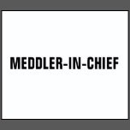
Proverbs 20:3 It is an honour for a man to cease from strife: but every fool will be meddling.

Slide 16
Proverbs 10:12
Hatred stirreth up strifes: but love covereth all sins.
Proverbs 15:18
A wrathful man stirreth up strife: but he that is slow to anger appeaseth strife.
Proverbs 16:28
A froward (contrary) man soweth strife: and a whisperer separateth chief friends.

Slide 17
Proverbs 22:10
Cast out the scorner, and contention shall go out; yea, strife and reproach shall cease.
Proverbs 26:17
He that passeth by, and meddleth with strife belonging not to him, is like one that taketh a dog by the ears.
Proverbs 26:20
Where no wood is, there the fire goeth out: so where there is no talebearer, the strife ceaseth.

Slide 18
Proverbs 26:21
As coals are to burning coals, and wood to fire; so is a contentious man to kindle strife.
Proverbs 28:25
He that is of a proud heart stirreth up strife: but he that putteth his trust in the Lord shall be made fat.
Proverbs 29:22
An angry man stirreth up strife, and a furious man aboundeth in transgression

Slide 19
2 Timothy 2:23
But foolish and unlearned questions avoid, knowing that they do gender strifes

Slide 20
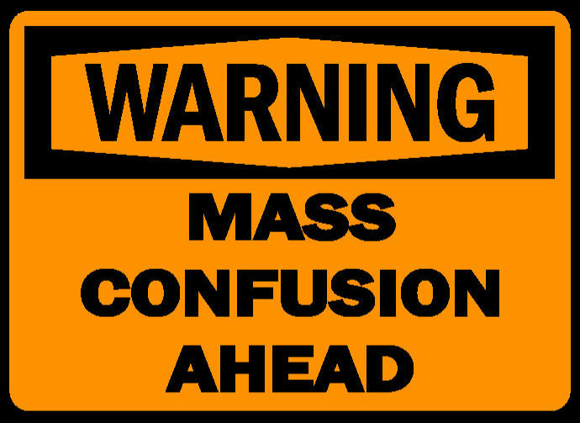
James 3:16 For where envying and strife is, there is confusion and every evil work.

Slide 21
Interactive Bible Study Question #5:
What are some ways to manage stress?

Slide 22
There are many ways to manage stress.

Slide 23
We have cares, but we have a Saviour.
1 Peter 5:7 Casting all your care upon him; for he careth for you

Slide 24
Don’t focus on the worst case scenario.
John 14:1
Let not your heart be troubled: ye believe in God, believe also in me.

Slide 26
Bible Study Next Wednesday 2/25 at 7pm. “Overcoming Emotional Strongholds”
Scriptures to review
Ruth 1:10-21, 4:14-17
1 Samuel 1:4-18
1 Samuel 30:1-8
2 Corinthians 4:7-15

