Slide 1
Walk By Faith
“walk by faith, not by sight” (2 Cor. 5:7).

Slide 2
Walk By Faith
What does it mean to you to walk by faith?

Slide 3
Walk By Faith
Don’t walk by sight. Your eyes can deceive you.
Judge not by the appearance of thing, it will get you into trouble.
The wrong impression about all the right things make all the right things seem like the wrong things.
The wrong impression about all the wrong things make all the wrong things seem like the right things. Don’t judge by appearances.

Slide 4
Walk By Faith
Your eyes were never meant to judge a situation.
Our eyes were meant to assist us in observing and evaluating a situation not making decisions based by what you see.
God’s promises more than our perceptions, and the way to find rest in the faithfulness of God.

Slide 5
Walk By Faith
Walking By Faith is not always easy.
It sometimes requires following the unseen into an unknown, and believing the Word of God over and against the threats we see or the fears we feel.
God is faithful. He will stand with us.
Without faith it is impossible to please him, for whoever would draw near to God must believe that he exists and that he rewards those who seek him” (Heb. 11:6).

Slide 6
Walk By Faith
We need to read the Bible in order to helps us grasp and live what it means to “trust in the Lord with all your heart, and . . . not lean on your own understanding” (Prov. 3:5).
One of the major goals of the bible is to help us believe in Jesus while living in a very confusing and painful world.

Slide 7
Walk By Faith
I Sam. 13:5-14
5.The Philistines mustered a mighty army of 3,000^{[a]} chariots, 6,000 charioteers, and as many warriors as the grains of sand on the seashore! They camped at Micmash east of Beth-aven. ⁶ The men of Israel saw what a tight spot they were in; and because they were hard pressed by the enemy, they tried to hide in caves, thickets, rocks, holes, and cisterns. ⁷ Some of them crossed the Jordan River and escaped into the land of Gad and Gilead.

Slide 8
Walk By Faith
Meanwhile, Saul stayed at Gilgal, and his men were trembling with fear. ⁸ Saul waited there seven days for Samuel, as Samuel had instructed him earlier, but Samuel still didn’t come. Saul realized that his troops were rapidly slipping away. ⁹ So he demanded, “Bring me the burnt offering and the peace offerings!” And Saul sacrificed the burnt offering himself.

Slide 9
Walk By Faith
¹⁰ Just as Saul was finishing with the burnt offering, Samuel arrived. Saul went out to meet and welcome him, ¹¹ but Samuel said, “What is this you have done?”
Saul replied, “I saw my men scattering from me, and you didn’t arrive when you said you would, and the Philistines are at Micmash ready for battle. ¹² So I said, ‘The Philistines are ready to march against us at Gilgal, and I haven’t even asked for the Lord’s help!’ So I felt compelled to offer the burnt offering myself before you came.”

Slide 10
Walk By Faith
¹³ “How foolish!” Samuel exclaimed. “You have not kept the command the Lord your God gave you. Had you kept it, the Lord would have established your kingdom over Israel forever. ¹⁴ But now your kingdom must end, for the Lord has sought out a man after his own heart. The Lord has already appointed him to be the leader of his people, because you have not kept the Lord’s command.”

Slide 11
Walk By Faith
When the storms of life hit, they almost always appear stronger to us than God’s Word. It is crucial for us to remember that our perceptions can be deceptive.
When circumstances strike fear into our hearts, the question we must ask ourselves is, where is your faith?”
In other words, we must learn to trust God’s promises more than we trust our perceptions.

Slide 12
Walk By Faith
“Forgetfulness and familiarity. Faith is often plagued by these twin faults. We easily forget what we know about who God is and what he’s done for us in Jesus Christ.
Remember Faith comes by hearing and hearing by the Word of God.
When we study the bible it helps us to remember just how wonderful our God is!

Slide 13
Walk By Faith
Ps. 135: 5-7
For I know that the Lord is great,
and that our Lord is above all gods.
Whatever the Lord pleases, he does, in heaven and on earth, in the seas and all deeps.
He is who makes the clouds rise at the end of the earth, who makes lightnings for the rain and brings forth the wind from his storehouses.

Slide 14
Walk By Faith (Your eyes can deceive you, don’t trust them)

Slide 15
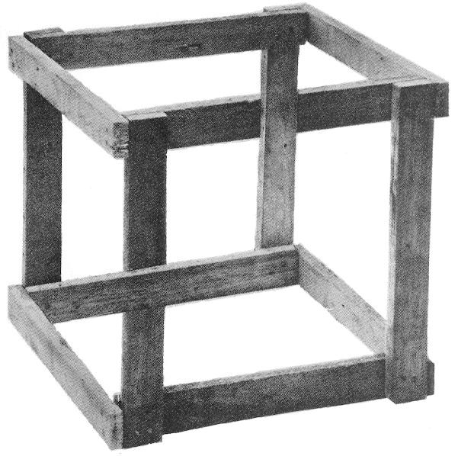
Walk By Faith (Your eyes can deceive you, don’t trust them)

Slide 16
Walk By Faith
Some times we strain to gain faith through what we see.
Faith is the substance of what is hoped for and the evidence that not seen.
If you see it, it’s not faith.
Do we strain to get hope from the things we can see?
When we walk by faith with Jesus, our blessed hope is in Him.

Slide 17
Walk By Faith
In walking by faith we need to remember God’s plan to save us when we were yet sinners. Do you need to be reminded of what you already know? Do you need to be shaken from your familiarity?
….For this purpose was the son of man manifested so that he could destroy the works the of the devil (I John 3:8).
Walk by faith-not by sight. We have victory through Christ.

Slide 18
Walk By Faith
What helps us to Walk By Faith
And truths about the greatness of Christ are the best ones for freeing us from unbelief. And to be freed from unbelief is to be freed from fear, greed, pride and anger etc.
The sight we need is not a sight of what the day holds, but a sight of who holds the day (God).
And even that sight happens by looking through the window of God’s word.

Slide 19
Walk By Faith
And he awoke and rebuked the wind and the raging waves, and they ceased, and there was a calm. He said to them, “Where is your faith?” And they were afraid. LUKE 8:24–25
“Where is your faith?” Where?
Is your faith in what you see.
If your faith is in what I feel.
When the storm, tragedy ,situation hit, do you trust in God and what He can do or in what you see?
Our we putting our trust in the power of the storm or circumstances?

Slide 20
Walk By Faith
When the storms of life hit, they may almost always appear stronger to us than God’s Word.
It is crucial for us to remember that our perceptions can be deceptive.
When circumstances strike fear into our hearts, the question we must ask ourselves is, where is your faith?
What God wants is for you to trust what he says over what you see.

Slide 21
Walk By Faith
Waiting on God is a common experience we may share.
Sometimes we wait for direction.
Sometimes we’re stuck in a very hard place and wait for release.
Sometimes we wait to understand his purposes.
Sometimes we wait for his provision.

Slide 22
Walk By Faith
Sometimes we wait for his provision.
Jesus’s timing and purposes are not always clear to us, though they are always best for us.
So he wants our faith resting on the rock of his Word and not on the sand of our circumstance.
Walk by faith and not by sight.

Slide 23
Walk By Faith
There are seasons where we may go through difficult situations.
There may be seasons where we will have to wait for God to answer.
God does not want us to panic during it either. He is in control of both.
When you don’t understand his ways, trust his Word. Pray and ask God to help you to know His acts as well as His ways.

Slide 24
Walk By Faith
References:
Not By Sight by Jon Bloom
To Judge or Not To Judge-Chris Centered Mall Teaching by David Holt Boshalt, Jr. 1998

